Slide 1
Invasives Management: Our Gardens and the Big Picture
Notes:
Intro to self and CISMA- The SuAsCo CISMA (Cooperative Invasive Species Management Area) is a partnership of organizations that intend to manage and control invasive species in the Sudbury, Assabet, and Concord (SuAsCo) watershed. The partners in this CISMA wish to share information, educate, and plan strategies for dealing with invasive species. This CISMA will protect the biological, aesthetic, cultural, historical, and recreational values of natural areas, farmland, water resources, and scenic vistas by cooperating, coordinating activities, and sharing resources necessary for the prevention and control of invasive species on public and private lands across ownership boundaries within the CISMA
How you can care for your gardens in concert with regional land managers to improve wildlife habitat

Slide 2
What’s the Difference?
Native | Non-Native | Invasive
Evolved in this region | From a different area but does not spread freely and not negatively impact wildlife habitat | From a different area and able to spread freely and negatively impact wildlife habitat
Notes:
Explain the difference between the 3 categories

Slide 3
What determines a plant invasive?
Massachusetts Invasive Plant Advisory Group (MIPAG) reviews potential species and recommends to the Commonwealth to prohibit
Categorized as Invasive, Likely Invasive, or Potentially Invasive
Can you answer Yes to these questions?
Non-native to Massachusetts area?
Potential to disperse and establish in high numbers to natural area?
Potential to disperse far away from introduction site?
Can it replace natives?
Is it here or in states nearby or those with similar climate?
Notes:
MIPAG is a group of professionals that represents all corners of plant management in the state with members from land trusts, non-profits, municipalities, federal/state agencies, garden centers, and nurseries. Together they review species and make a single recommendation to the state if a plant should be added to the prohibited plant list. The State then decides to either accept or reject their recommendation.
There are three categories for how a plant can be listed on the prohibited plant list; Invasive (the non-native species is here in MA and spread into native or minimally managed plant systems and cause economic or environmental harm), Likely Invasive (non-native species is naturalized in MA but does not meet full criteria to be considered “Invasive”), Potentially Invasive (non-native species not currently known to be in MA but is expected to become invasive in minimally managed areas).
There are many characteristics that a species must meet to be considered invasive. Here are some of the questions that are considered during the review process.

Slide 4
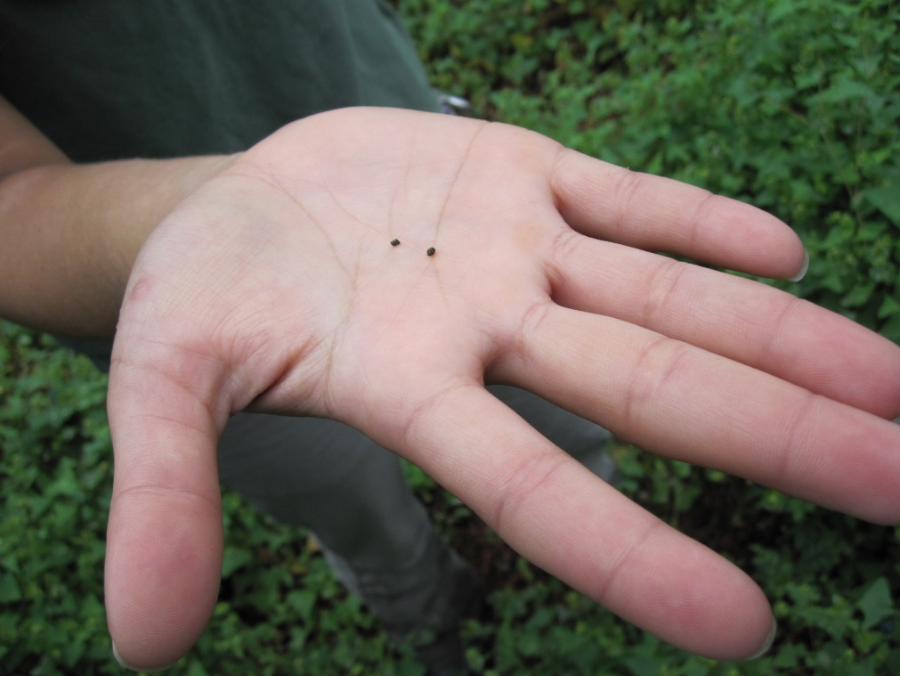
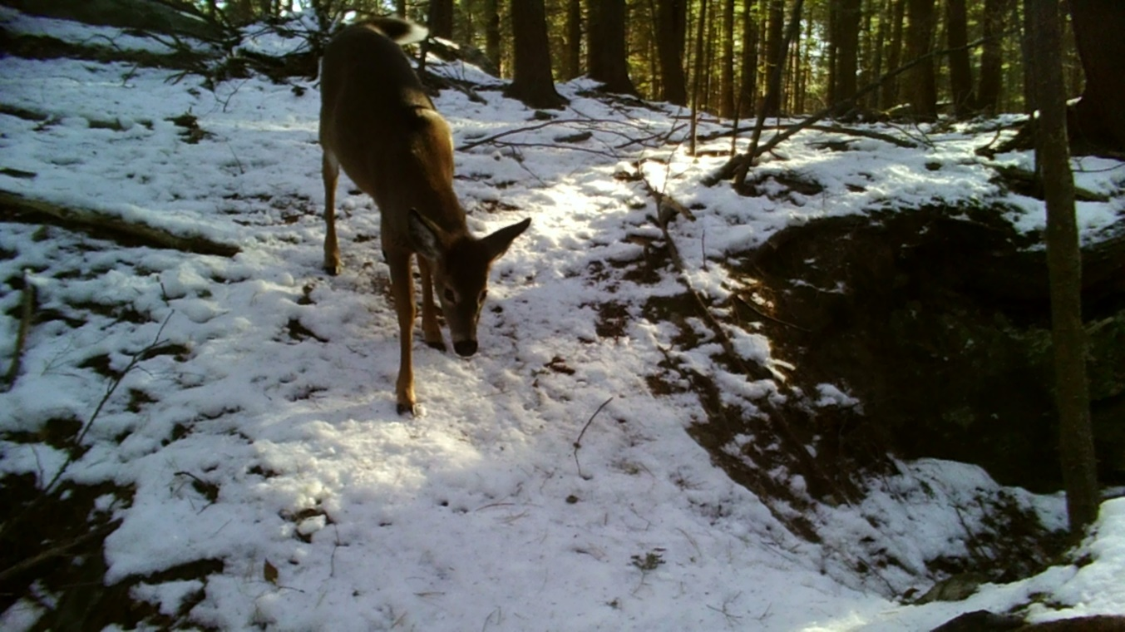
Why do invasives do so well?
Predator release
Filling a gap niche
Creates ideal habitat for itself but not natives
Growing season starts earlier and ends later
Dispersal methods- rhizomes, seed number/viability
Typically tolerant of a variety of conditions
Notes:
Why do invasives do so well? There are several reasons invasives can outcompete our natives and get a foothold in our natural areas. Many species meet several of the reasons we are about to go through.
Predator release- When the invasive is in it’s native range they typically have a natural predator that helps keep the population in check such as an herbivore that eats the foliage and suppresses growth or flowering. In the new area there is no existing predator that would suppress plant growth. Deer don’t really eat, or at least prefer to eat majority of our worst offenders.
Filling a gap niche- A niche is the functional role that species plays within the habitat. If the habitat in question has functional role or gap not filled a non-native with that ability can easily fill that needs. For plants that could be is it an understory plant that can grow in shade and deer won’t eat it. Japenese barberry meets those qualifications and in sparse woods they can be easily found.
Creates ideal habitat for itself but not natives- Garlic mustard secretes an allelopathic chemical from its roots that suppresses the growth of natives around it leaving more space for the garlic mustard.
Growing season- Many of our invasives leaf out weeks before our natives and retain their foliage well after the natives have gone dormant for the winter. This gives them more time to acquire nutrients to expand their roots and overall size.
Dispersal methods- Some plants can spread from rhizomes (a small piece of root) that break off. Knotweed can spread down stream easily this way. Or they have very tiny seeds that will stick in the mud of your boots or tires. The seeds could also be viable after 10 years. The fruit can look very attractive to birds or other wildlife but has no/little nutritional value and will pass quickly through the animal.
Tolerant of variable conditions- They can withstand hot/dry or cold/wet. Sun or shade

Slide 5
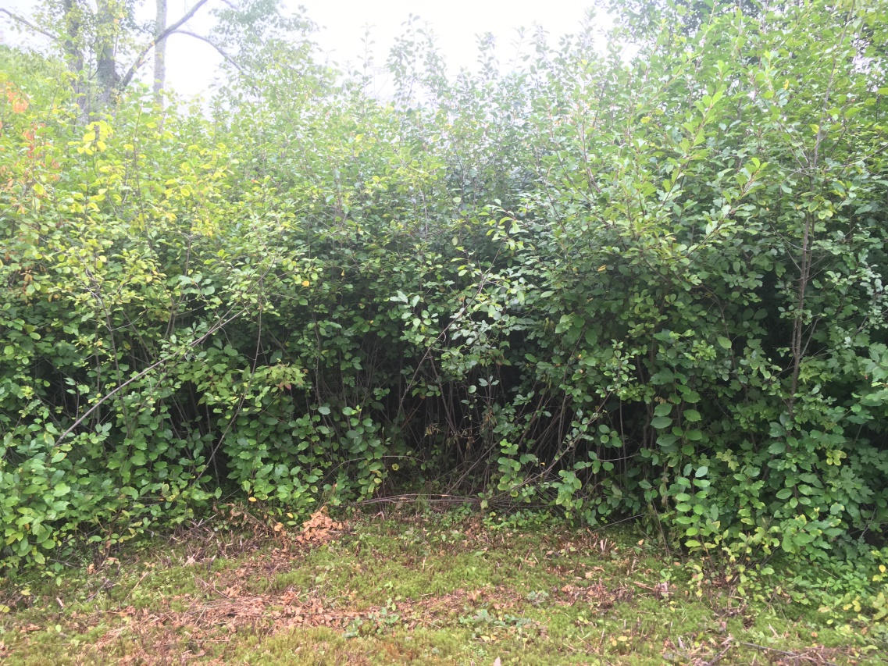
Ecological Impacts
Replace native plants with monocultures
Loss of preferred or ideal food source (birds, pollinators)
Changes in plant structure and height (perching, nesting, foraging)
Light, water, or space availability changes
Alters natural species succession
Overall loss in species diversity
Notes:
There are many ecological impacts an invasive can have on a habitat. Many can form dense thickets, such as the glossy buckthorn in this photo. This patch is extensive and there are so many buckthorn individuals packed so close together that there is nothing growing under them but more buckthorn. When we lose space for our native plant species we are losing preferred and high quality food sources for birds and pollinators, we lose perching, nesting, and foraging spaces, and the availability of light, water, and space can change which will impact what species can grow there.
Long term this type of monoculture will prevent natural species succession. If this is the understory of a forest there will be no tree seedlings in this patch so when a canopy trees falls there is nothing to replace it.
All of this results in an overall loss of species diversity. We will see impacts on current and future plants, birds, insects, soil chemistry, and water availability.

Slide 6
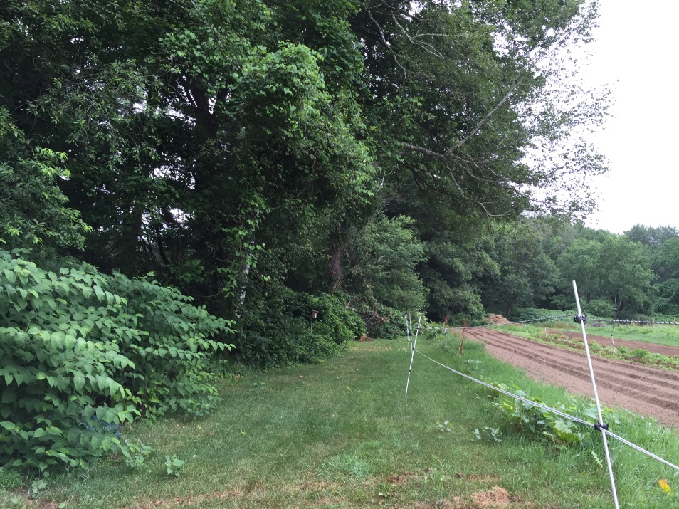
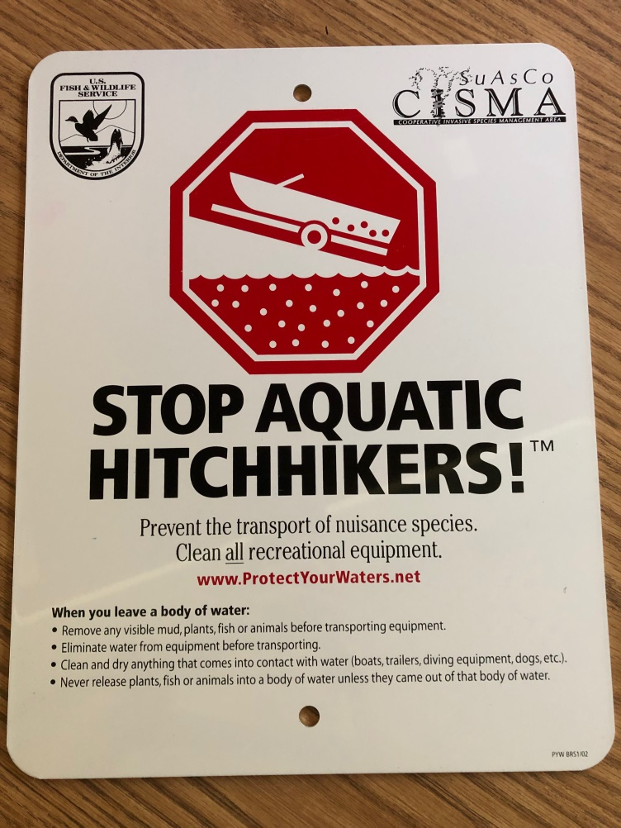
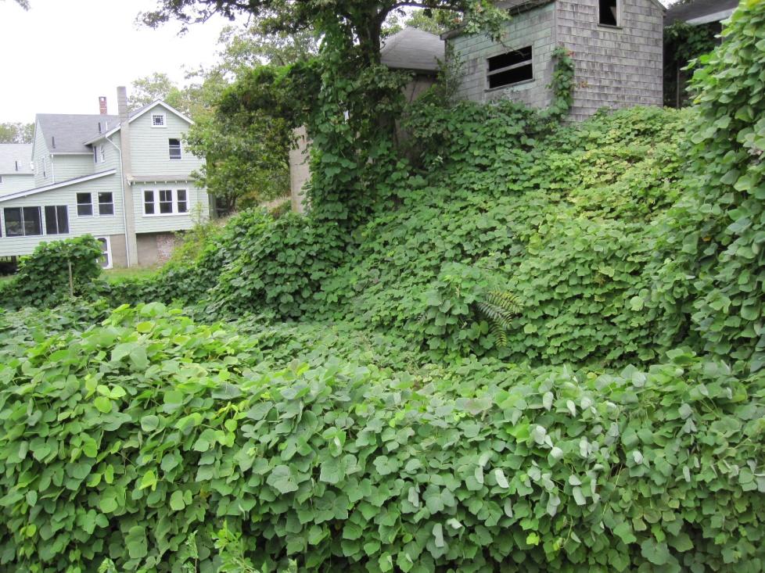
Invasive species cause $120 billion in damages each year and this number is only increasing
Notes:
The last national report I could find was from 2005 which determined that invasive species have cause $120 billion in damages per year and that number is only increasing. Damages assessed included aquatics clogging waterways or impacting vessels (for example zebra mussels in the Great Lakes or water chestnut in MA waterways), invasives impacting farms by encroaching into fields or altering soil chemistry. Invasives can also degrade houses or infrastructure, Japanese knotweed can grow through pavement or kudzu that can encase houses or cover roadways.

Slide 7
We need your help
Most management is done by professionals
Natural land managers
Highway departments
Farmers
Boaters
Powerline companies
Notes:
Most invasive management is done by natural land managers, highway departments, farmers, boaters, powerline companies and sometimes private landowners but we can’t do it alone. We need your help.

Slide 8
You have invasives, now what?
Notes:
You want to help… now what? It is import to know what you are dealing with so that you know how to properly remove the plant. Many of our invasives respond differently to certain removal techniques and sometimes you can make the situation worse. First, we will go over the different ways an invasive can be removed and disposed of then we will get into the details you’ll need for some of our worst offenders.

Slide 9
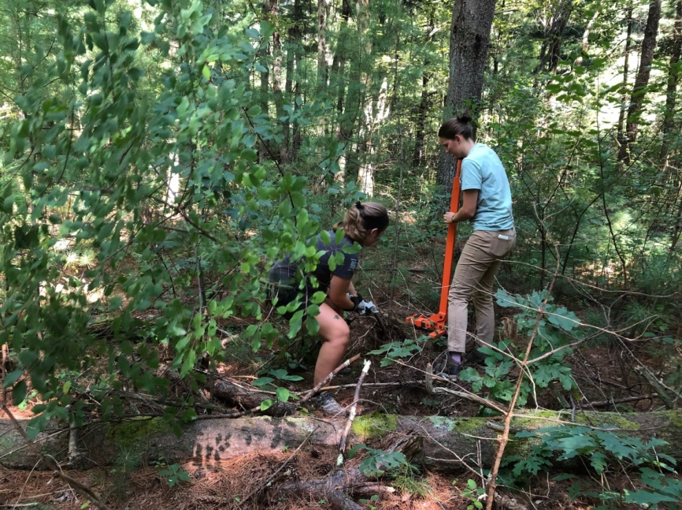
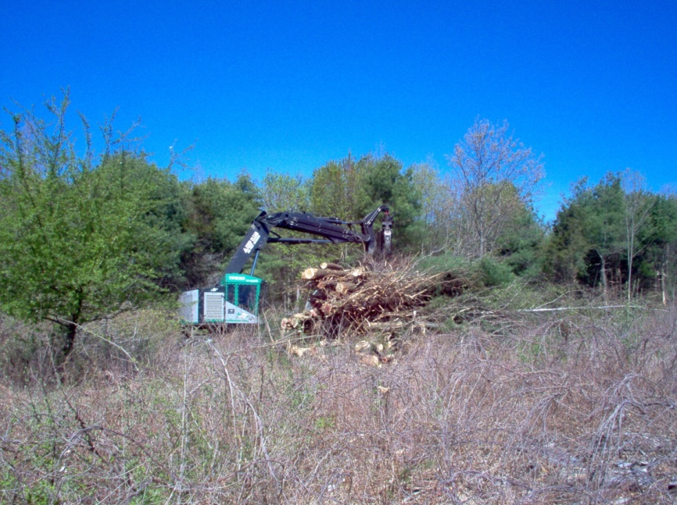
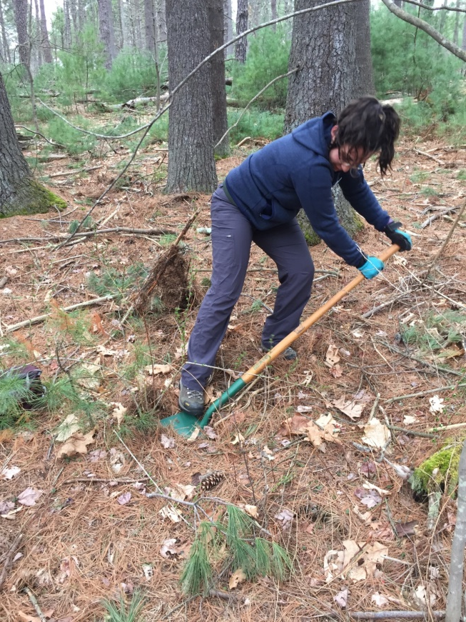
Manual /Mechanical Removal
Notes:
Manual or mechanical removal is when you are physically removing the plant from the ground. Manual removal includes hand pulling or the using weed wrench (the orange tool that helps you leverage the roots out of the ground) or digging the roots out with a shovel. Mechanical removal is when machinery is involved to remove the roots, so a tractor to pull the roots or something larger.

Slide 10
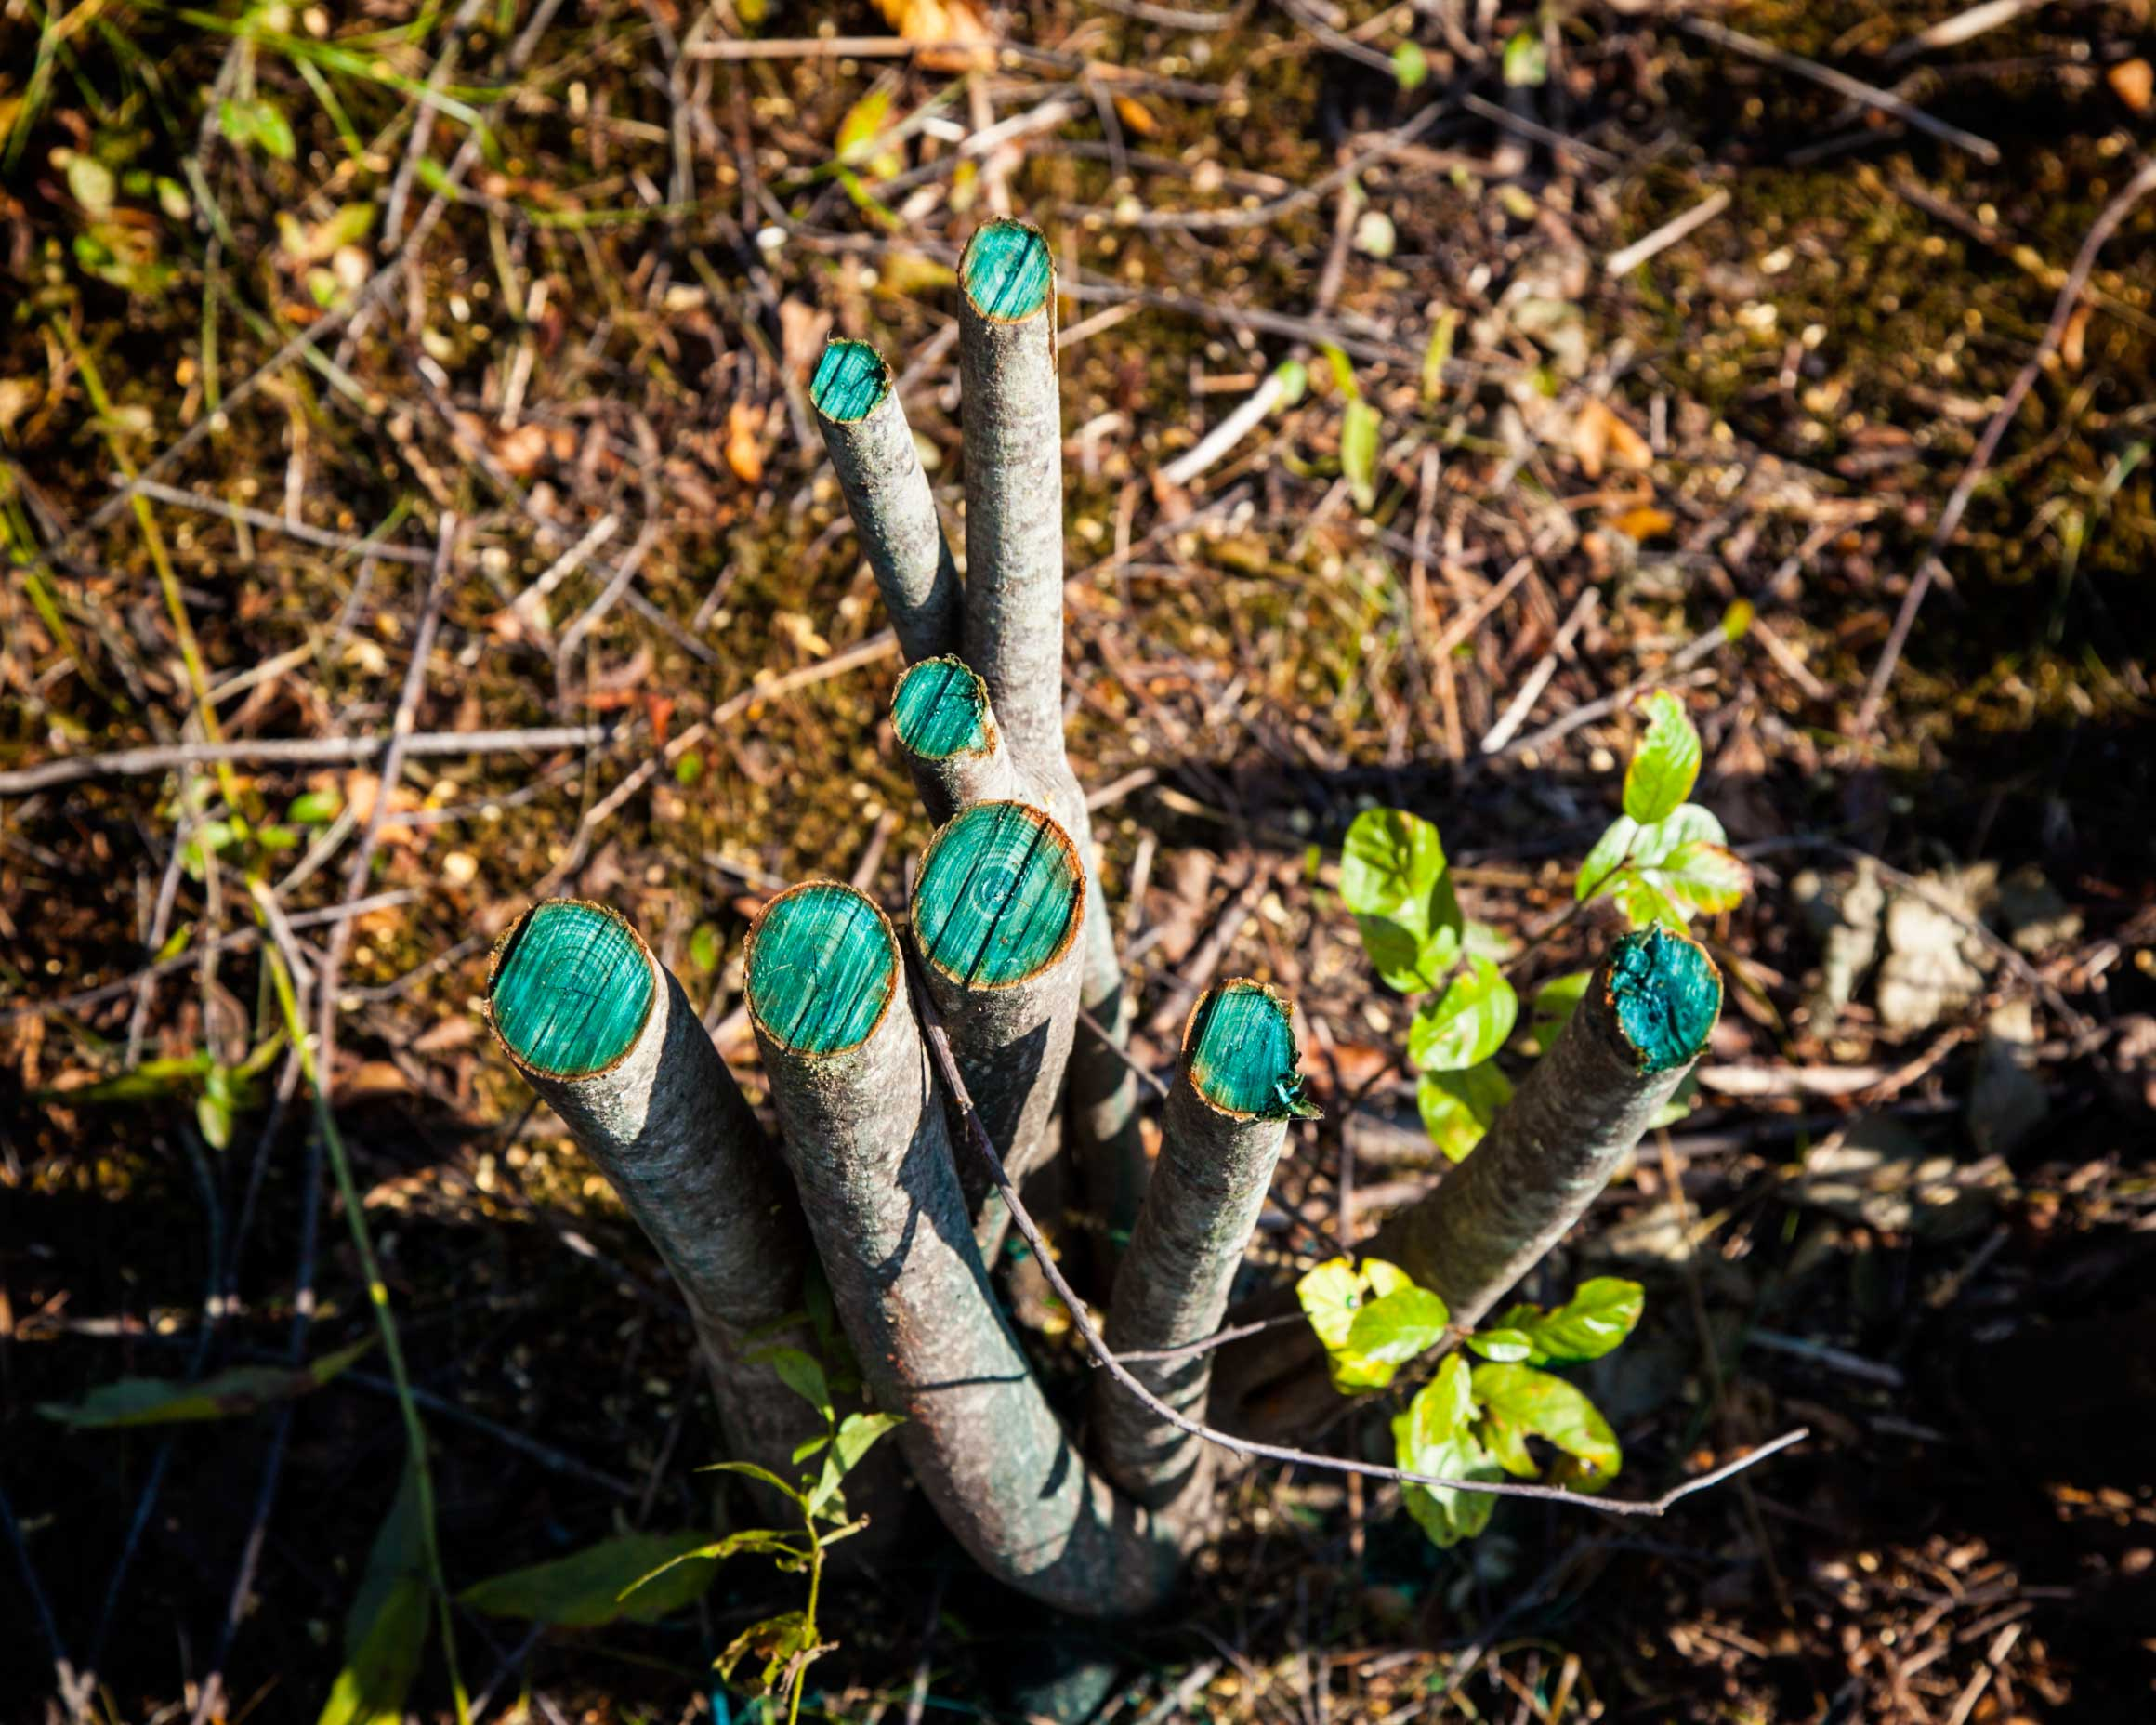
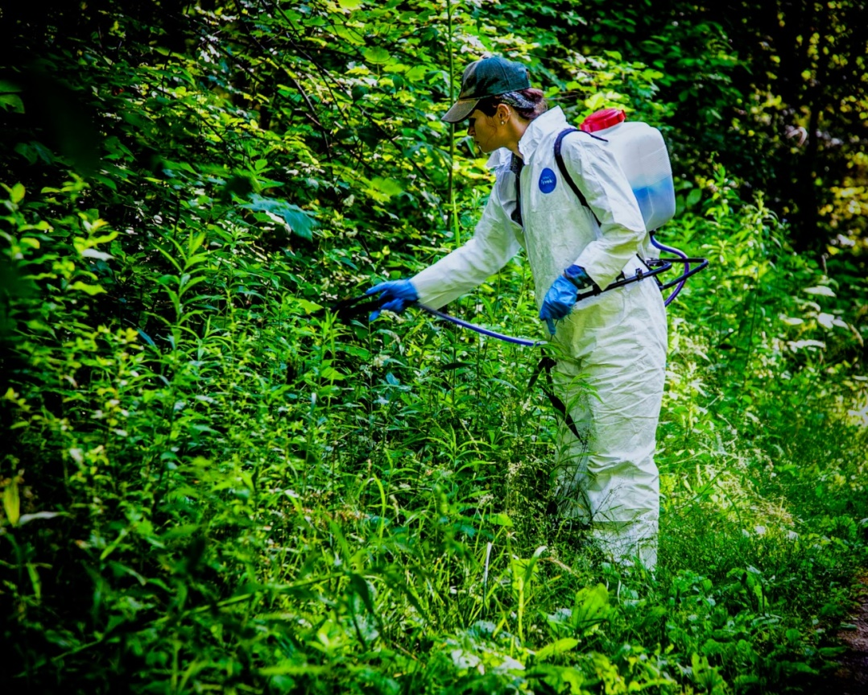
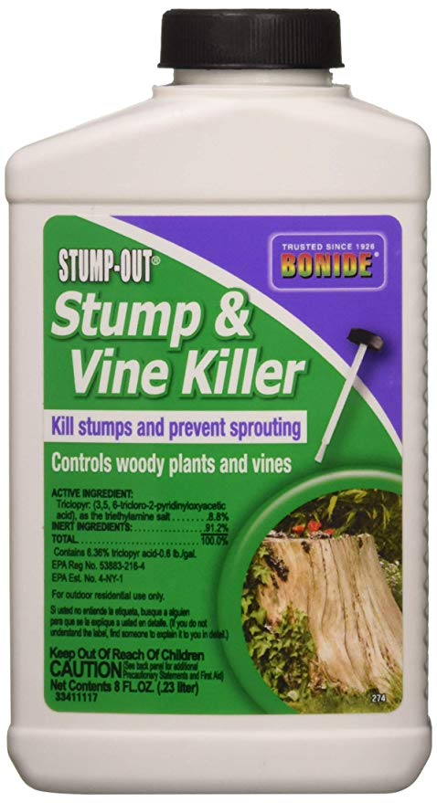
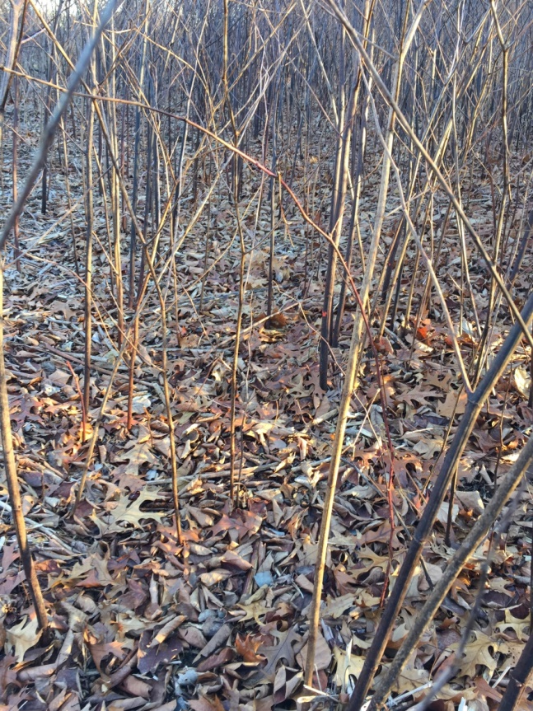
Selective Herbicide Treatment
Notes:
Selective herbicides are usually our most effective tool against invasive plants and we are able to apply them in very direct applications that the dramatically reduce risk of impacting unintended plants or contaminating soils. In some instances the treatment method will essentially prevent that impact altogether. Unless you are a the homeowner you must have a state issued applicators license to apply herbicides on a property. The most common methods of herbicide treatment are
Cut and paint- which is when you cut the stump of a woody plant and paint the herbicide directly onto the stump. The blue in the photo is a dye that applicators often add to track which stumps were treated. As a homeowner if you are tackling a small patch you can used a product like Stump and Vine, which has a paint brush built into the lid.
Selective spot spraying- This is often done with a backpack sprayer and a small nozzle and the applicator sprays the leaves of the target plant directly (about 6 in from the foliage)
Injection-This is a newer treatment that works best on knotweed and the applicator injects herbicide directly into each stem
Glove treatment- The applicator uses a specialized glove that has herbicide on the palm. The applicator then grabs and swipes the trunk
All of these methods use the bare minimum of product needed and is chosen based on the invasive and it’s abundance. For instance, spot spraying is best when the invasive is clumped and there are no desired plants in the immediate area. Applications are typically limited to one a year and if planned and executed well you should see 80% reduction in the first year. Follow up applications maybe required for a few years after but each one would require less and less product.

Slide 11
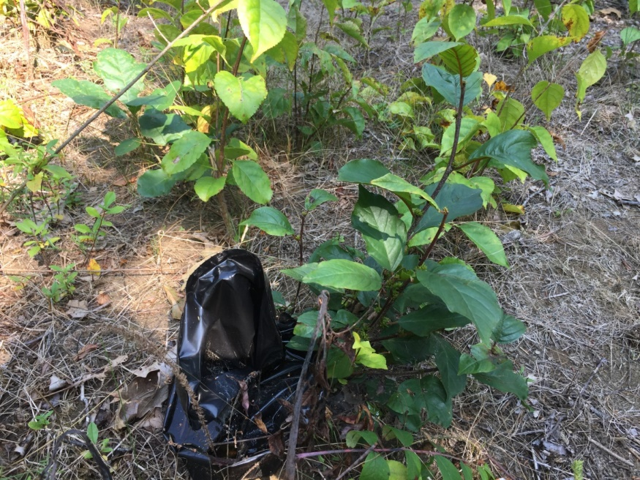
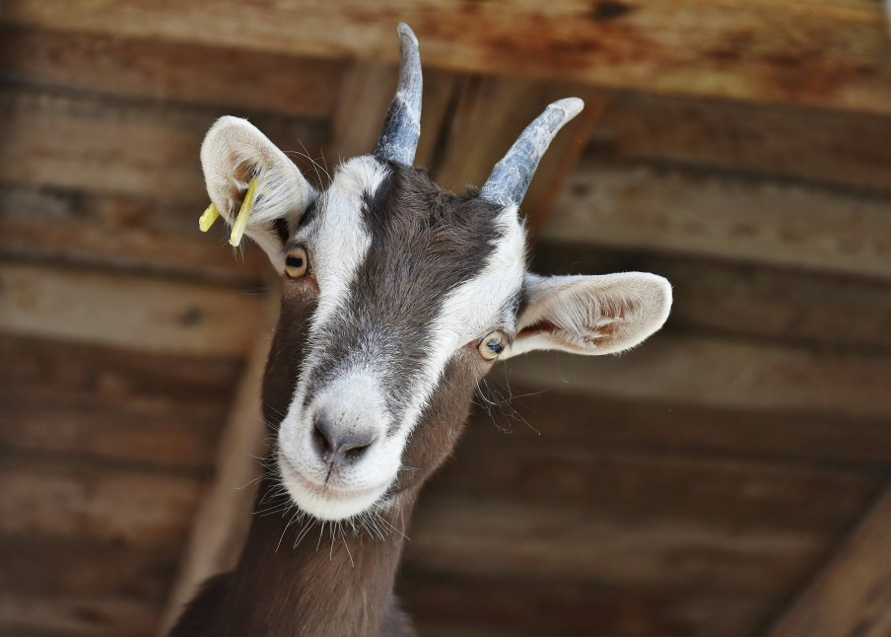
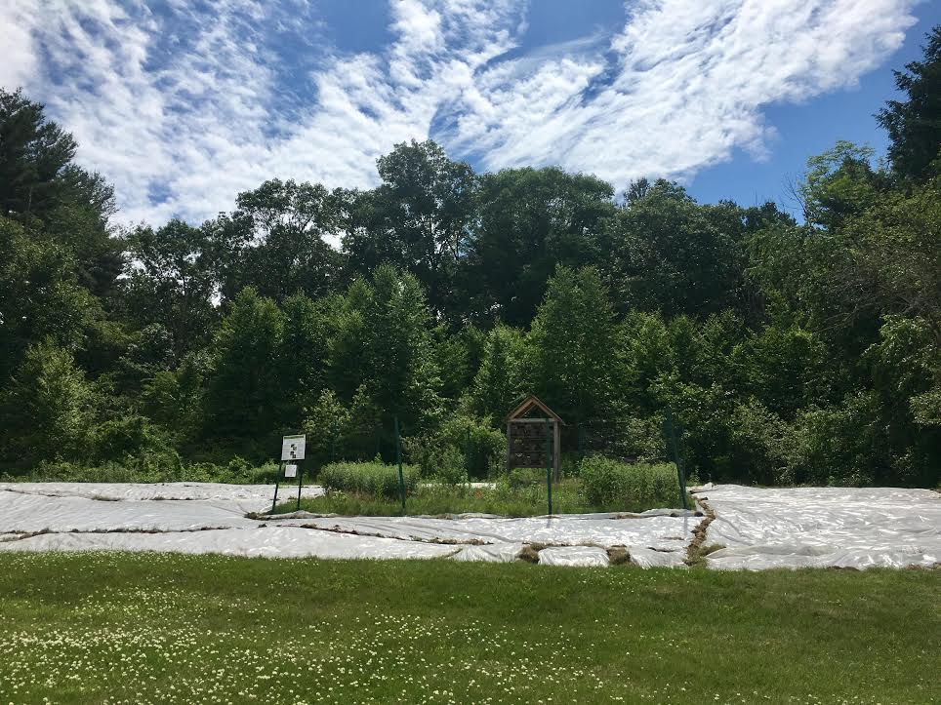
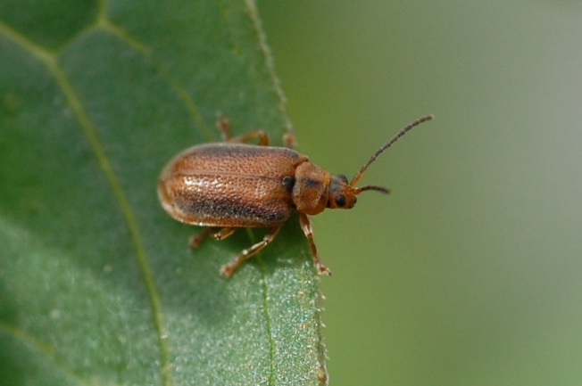
Other Types of Treatments
Notes:
There are other treatment option come with varying success. These include
Buckthorn baggies- thick black plastic bags that you place over the cut stump. This is about 50% effective and requires a lot of time to set up and remove
Solarization- a plastic sheet that covers an area to increase soil temperature to kill roots or seeds in the top few inches of soil- This requires a lot of time to set up/remove, it can negatively impact the mycorrhizal in the soil/ native seeds, and it only impacts the top 2-3 inches so if you have seeds deeper and the soil is disturbed or if there are mature invasives next to the area new seeds can germinate.
Biocontrols- these are usually insects and must go through rigorous testing lasting years and years to be sure they will not impact other plants. These controls are usually predators from the plants native range. Sometimes the biocontrol is only effective to a point and will simply contain the population.
Goats!- The cutest management tool but they will eat everything. Since they don’t know the difference between native and invasive you have to select an area where their impact on natives won’t be detrimental. This is also a very expensive option, you need to hire a heard, someone to make sure they have water, fix the fence, catch them if they escape. If the heard can’t stay for years then they are often the first treatment to literally cut back the infestation and a follow up treatment is applied.

Slide 12
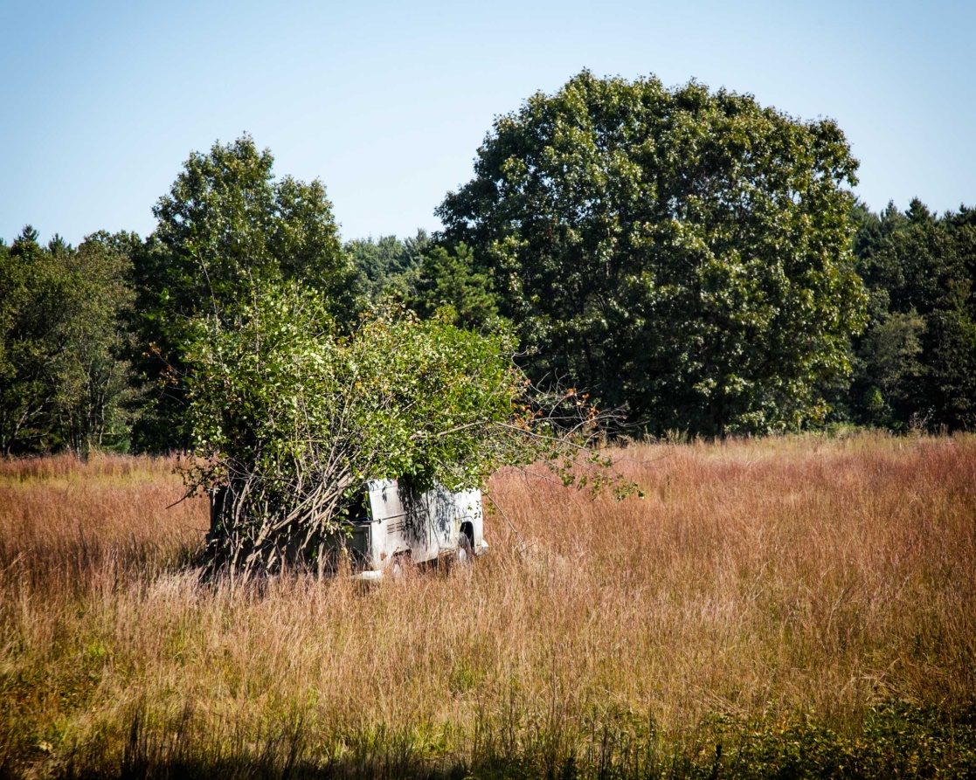
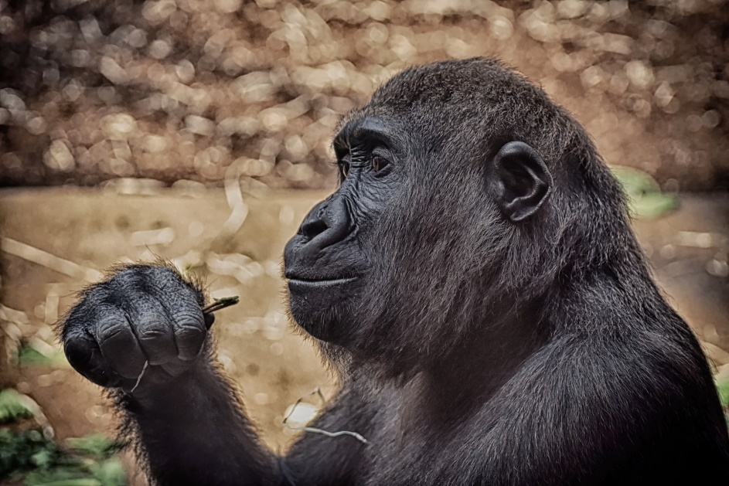
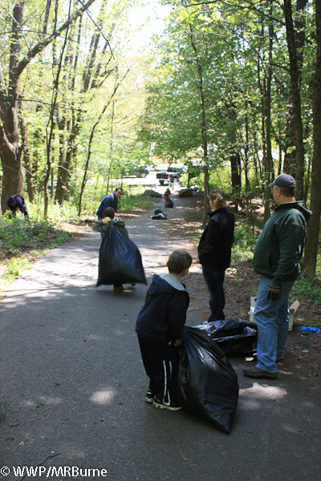
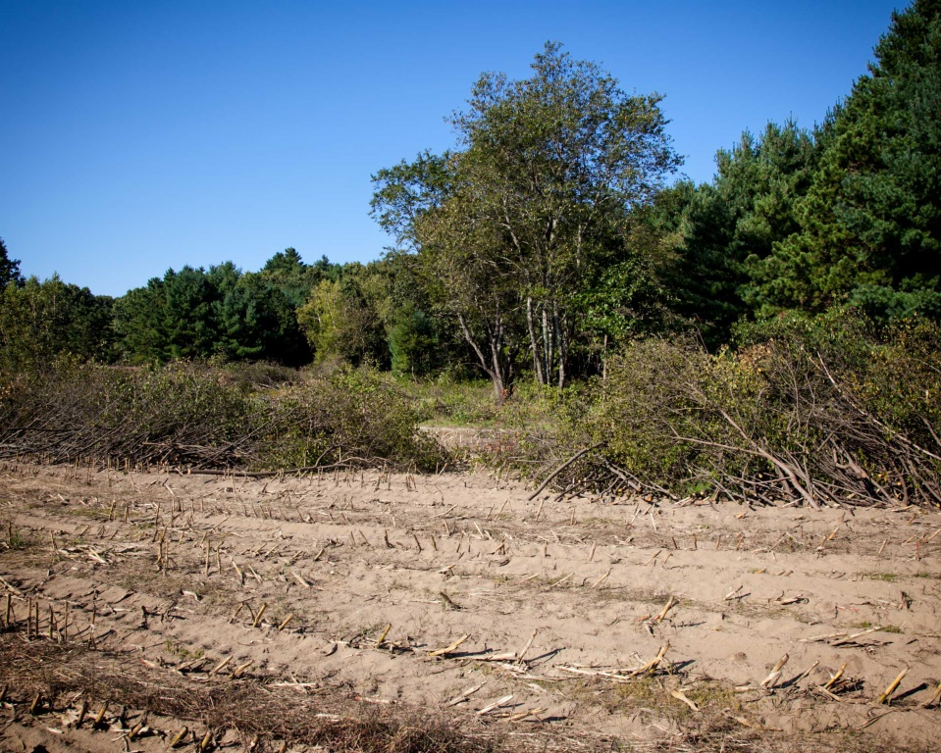
Disposal
Notes:
Planning your disposal method is important.
You can truck it to a more desirable location to pile for long-term compost or to burn. Some groups with regular loads will have an arrangement with an incinerator power company.
Create an invasive brush pile- this will contain any future growth from seed or root to a targeted area
Dry it- this is best for herbaceous plants. You can either bag it or leave it on your driveway until it is dried out them compost it. (don’t put garlic mustard in your regular compost)
Get the roots off the ground by hanging them in a crook of a tree, or placed on a downed tree or large rock until dried out
Zoos will take some invasives like knotweed to feed wildlife. The stalks won’t have seed or roots and are enjoyed by gorillas and others. This is a fun option if you a large or regular load.
Burn hang or zoo ☺

Slide 13
What invasives could you have on your property?

Slide 14
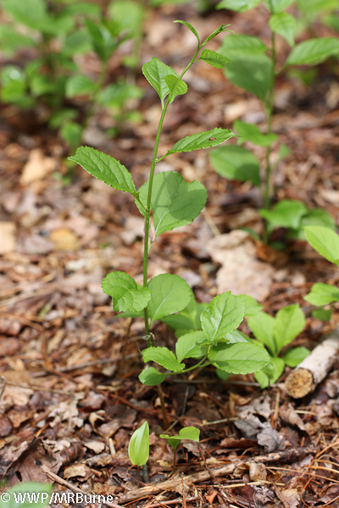
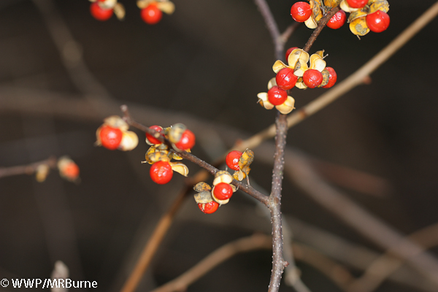
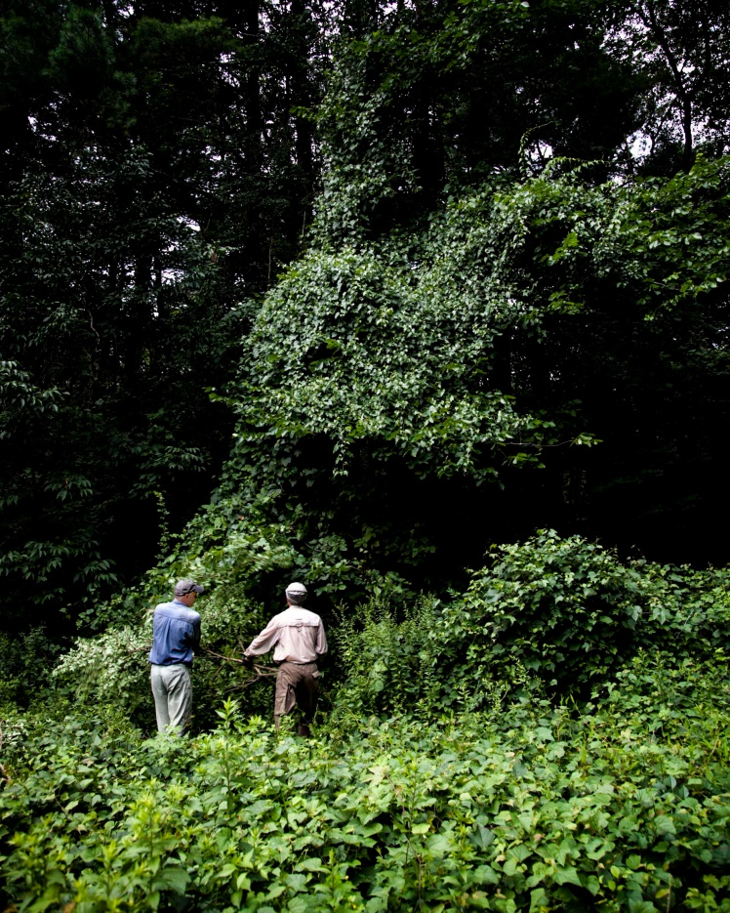
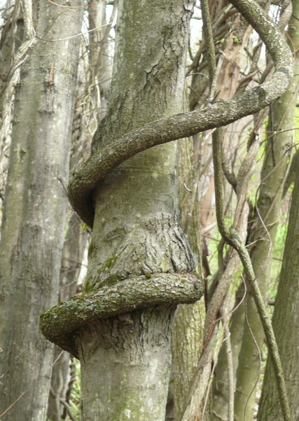
Oriental Bittersweet Celastrus orbiculatus
Vine (+60 ft tall)
Introduction- Ornamental
Habitat- Forest edge, open woodlands, disturbed areas, fields. Shade tolerant!
Spreads- Seeds and root suckering
Ecological Threat- Killing vegetation through smothering or girdling
Ideal treatment- Cut and paint
Notes:
Native has terminal flowers vs multiple leaf axils

Slide 15
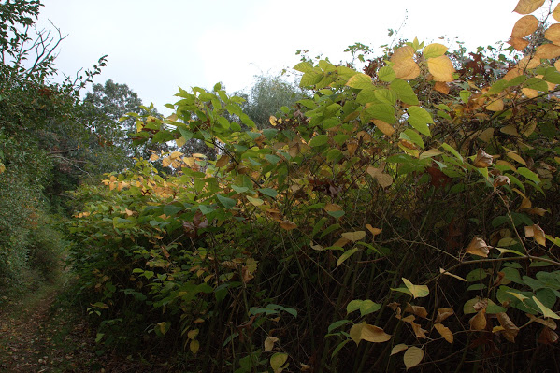
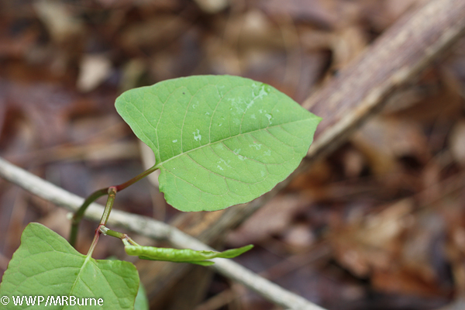
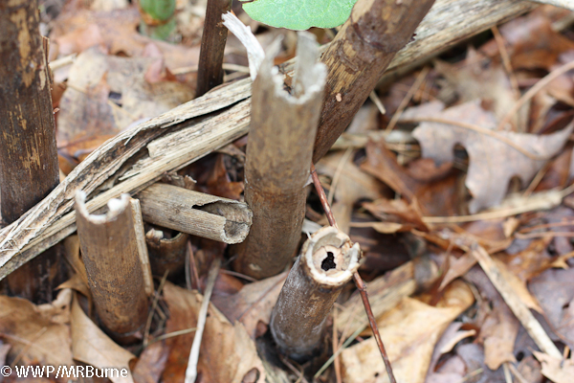
Japanese Knotweed Fallopia japonica
Herbaceous Perennial (+ 10 ft tall)
Introduction- Ornamental, erosion control, hedge
Habitat- Typically wet soils. Shade, drought, salt, and heat tolerant.
Spreads- Seeds and rhizomes (can travel down stream)
Ecological Threat- dense thicket shades out natives and clog waterways/culverts etc.
Ideal treatment- foliar spray or injection. Hand pull if small
Notes:
Possible bio control

Slide 16
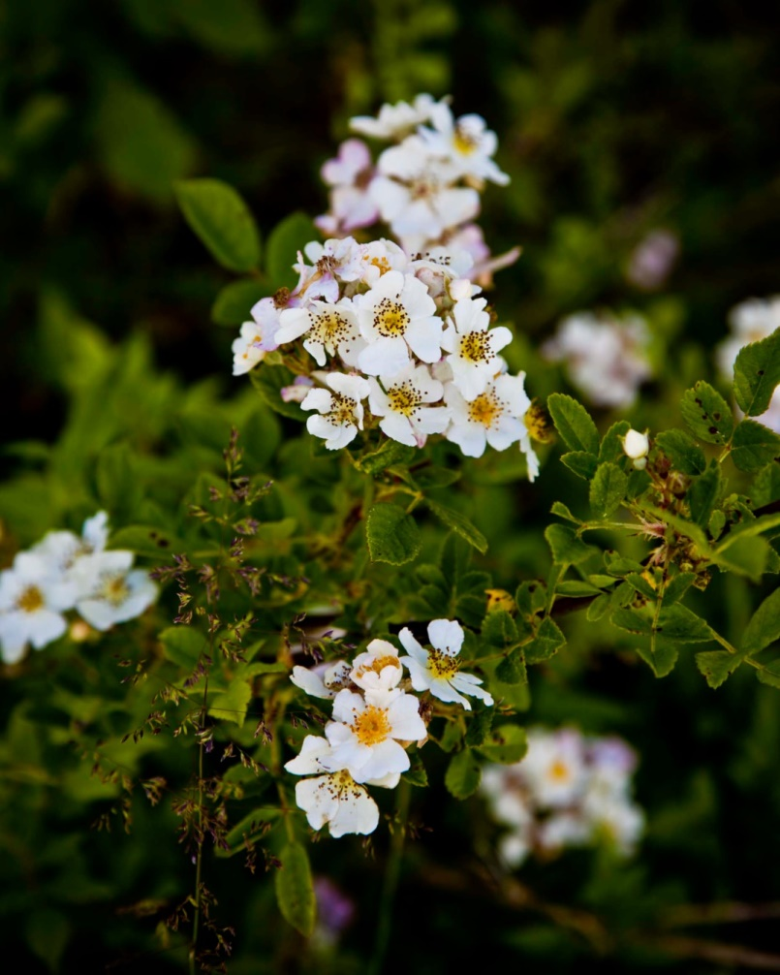
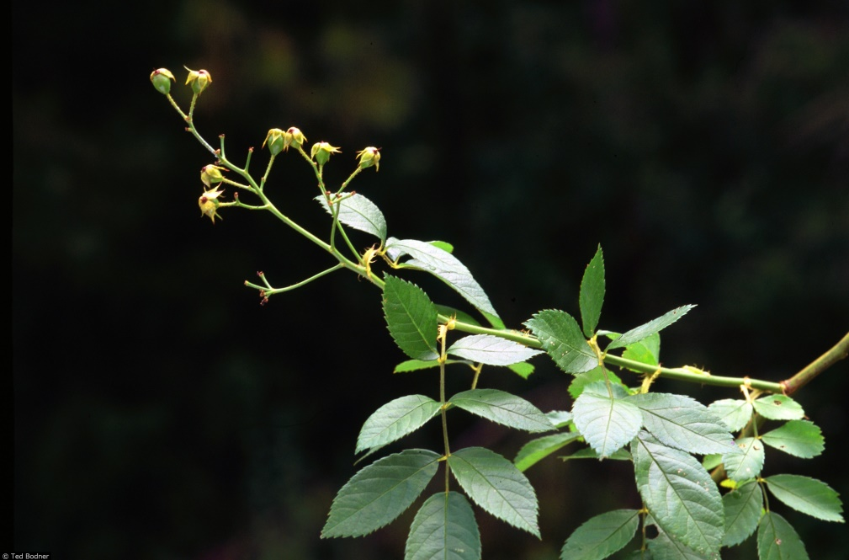
Multiflora Rose Rosa multiflora
Shrub (+ 15 ft tall)
Introduction- Ornamental and livestock fencing
Habitat- Wide tolerance for soil, moisture, and light conditions
Spreads- Seed and cane tips rooting
Ecological Threat- Dense thicket shades out natives and impact bird nesting
Ideal treatment- Combo manual/mechanical removal and chemical treatment
Notes:
Invasive has white flowers (though buds or young flowers can be pinkish), stipules are fringed, and the thorns hook backwards

Slide 17
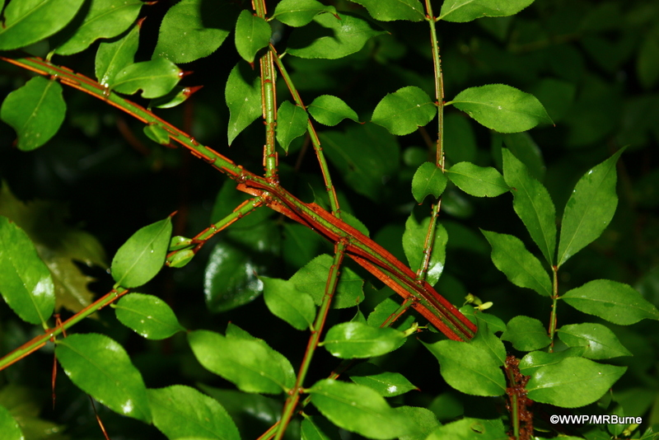
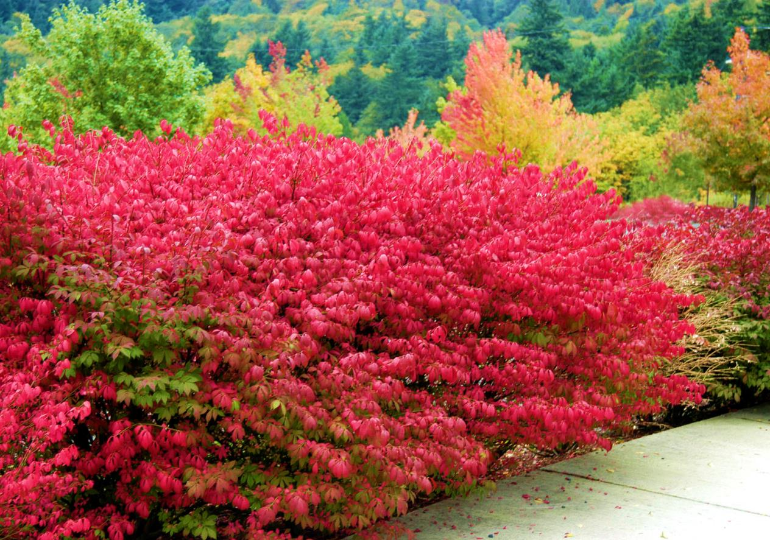
Burning Bush Euonymus alatus
Shrub (5-10 upto 20 ft tall)
Introduction- Ornamental
Habitat- Forests, coastal scrublands, prairies
Spreads- Seeds and vegetative reproduction
Ecological Threat- Dense thickets replace natives
Ideal treatment- Hand pull smaller plants. Repeated cuts or cut and paint
Notes:
Extremely common in landscaping

Slide 18
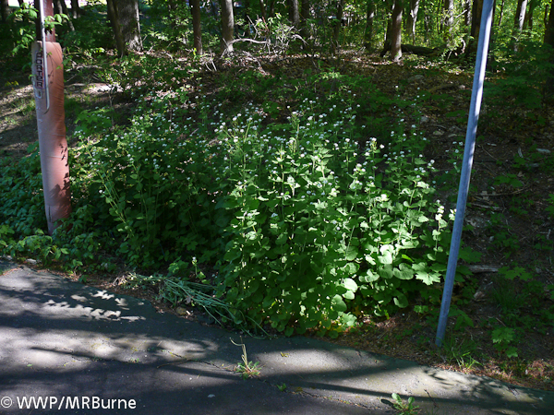
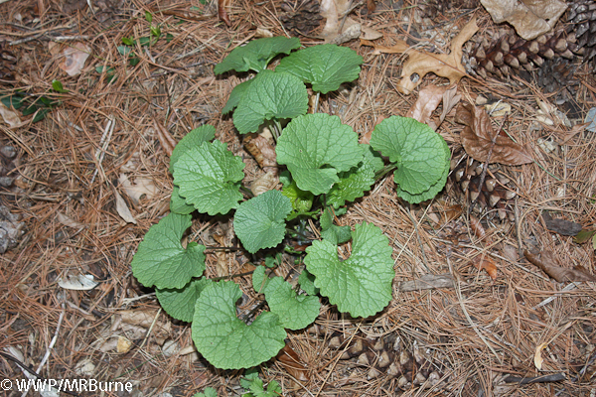
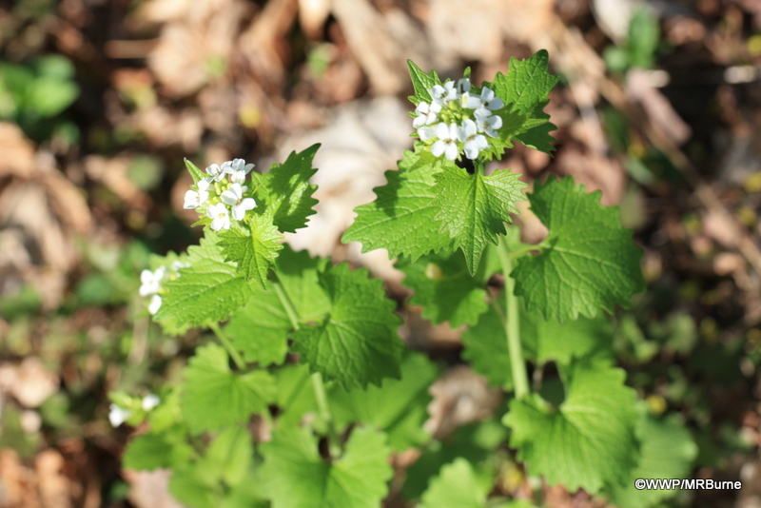
Garlic Mustard Alliaria petiolata
Herbaceous Biennial (1-4 ft tall)
Introduction- Food/medicinal
Habitat- Moist to dry forests, roadsides, disturbed areas
Spreads- Seeds carried by wind, water, people and wildlife
Ecological Threat- Changes soil chemistry preventing native wildflowers and tree seedling growth. Several of which host 3 butterflies. Toxic to butterfly larvae
Ideal treatment- Hand Pull. Cut back before it sets seed if can’t pull

Slide 19
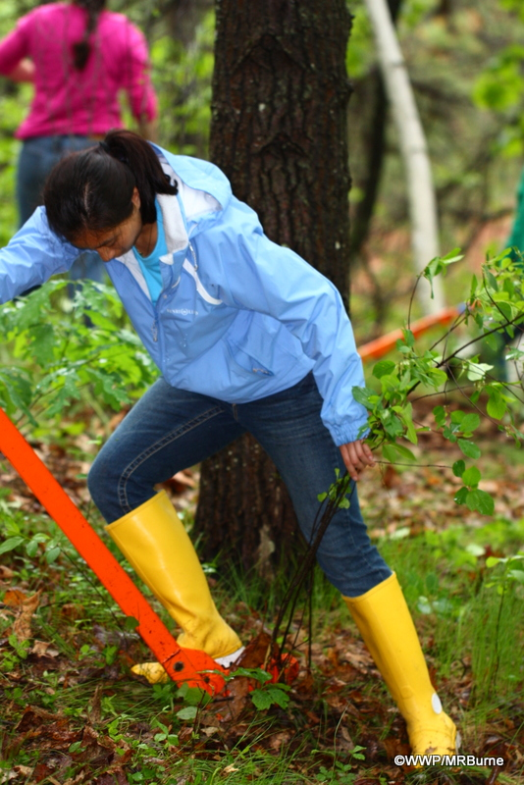
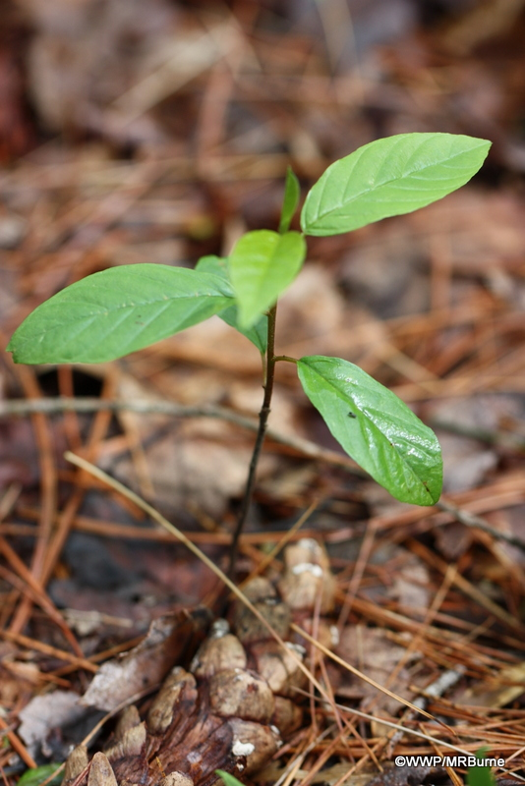
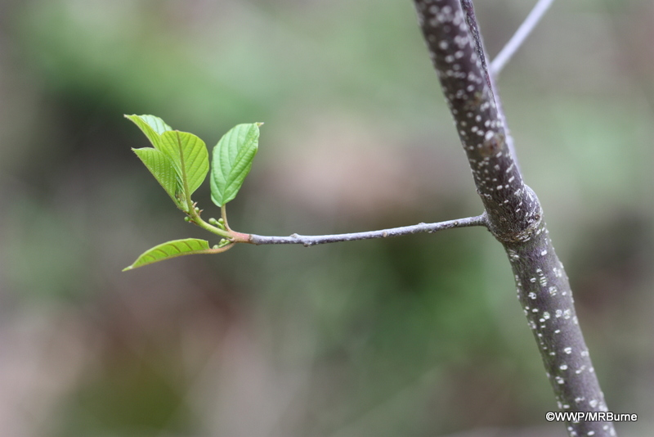
Glossy Buckthorn Frangula alnus
Subshrub/Tree (20-25 ft tall)
Introduction- Ornamental, Hedge
Habitat- Typically in wet soils, sun or full shade. Can establish in dry soils
Spreads- Seed
Ecological Threat- Dense thicket displaces natives
Ideal treatment- Pull smaller individual. Cut and paint larger ones. Buckthorn bags 50% effective

Slide 20
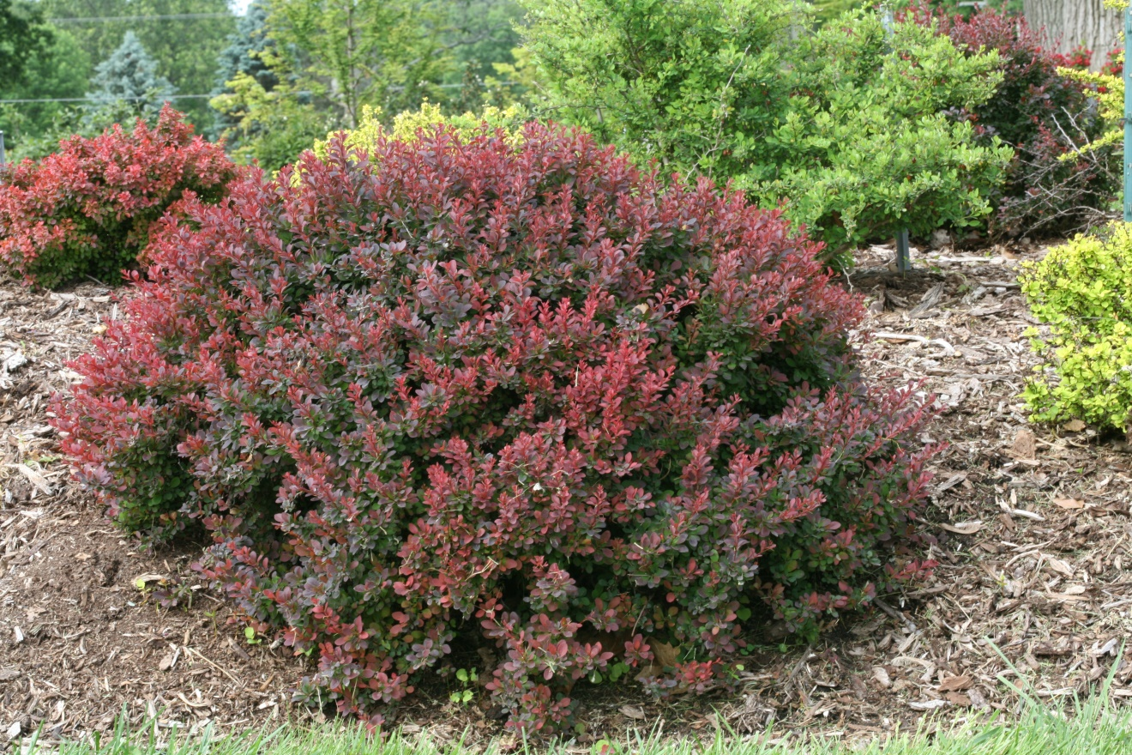
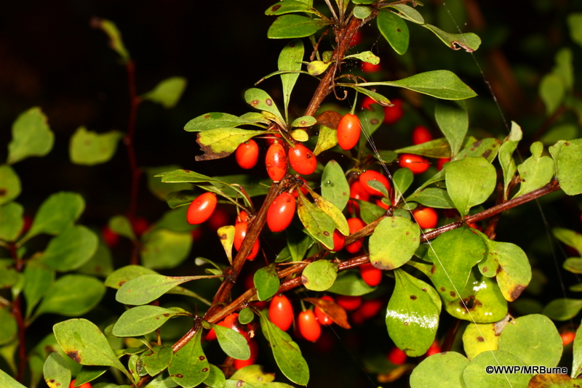
Japanese Barberry Berberis thunbergii
Shrub (3-6 ft tall)
Introduction- Ornamental
Habitat- Sun to deep shade, forest, wetlands, fields etc.
Spreads- Seeds, root creepers and tip rooting branches
Ecological Threat- Displaces natives, changes soil pH, promotes Lyme Disease
Ideal treatment- Hand pulling, repeated mowing/cutting
Notes:
Extremely common landscape plant especially in purple form.

Slide 21
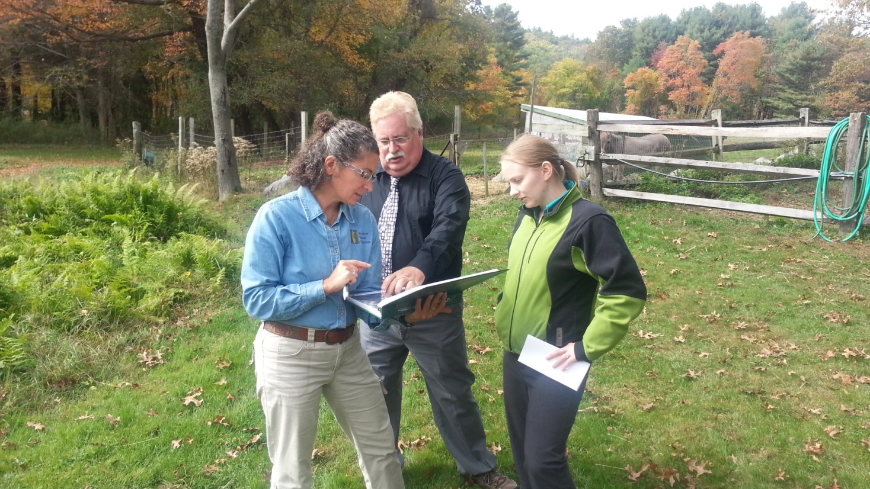
Use the land managers approach
Identify species present
Determine end goal- eradiation or maintain edge?
Removal and disposal based on the plants and goal
Choose natives to plant
Develop a long term plan
Notes:
You know you have invasives on your property, now what? Use the same approach that land managers use and follow these steps
Identify the species you have and their abundance (is it one barberry in a flower bed vs the forest edge is bittersweet taking down trees)
Determine you goal- do you want to ‘eradicate’ the barberry or contain the bittersweet so it won’t get worse
Determine the best removal technique for each species you have and how you plan to dispose of them
After treatment will you have a whole that needs a plant? Pick your native plant to replace it with.
You have a plan for this year! What about next year if it comes back? The more plants you are dealing with the longer you should plan to invest.

Slide 22
How to choose your natives
For a no fuss, low maintenance, high impact garden
Notes:
A well planned native garden should require almost no work from you once established. Take the time now to choose the ones best suited for your space to save yourself time, money, and back aches. Answer the following questions.

Slide 23
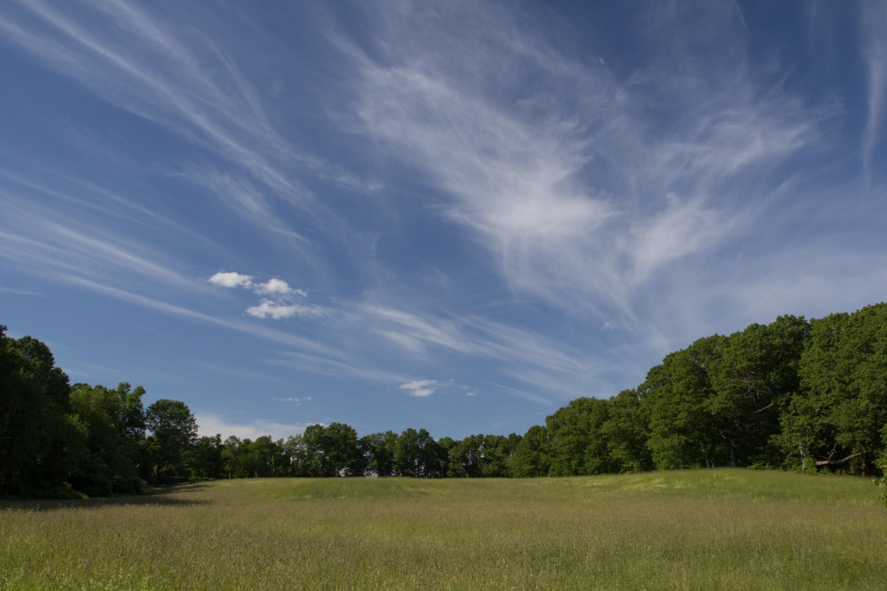
Determine your ‘habitat’ conditions
What is your soil like without your assistance?
Dry
Wet (all the time or seasonally)
Clay
Sand
How much direct sunlight do you have?
Full sun- direct light for 6+ hrs/day
Partial sun/shade- direct light for 3-6 hrs/day
Full shade- direct light for less than 3 hrs/day
Notes:
These questions are essential to planning out your garden. A full sun plant in a full shade area will not last.

Slide 24
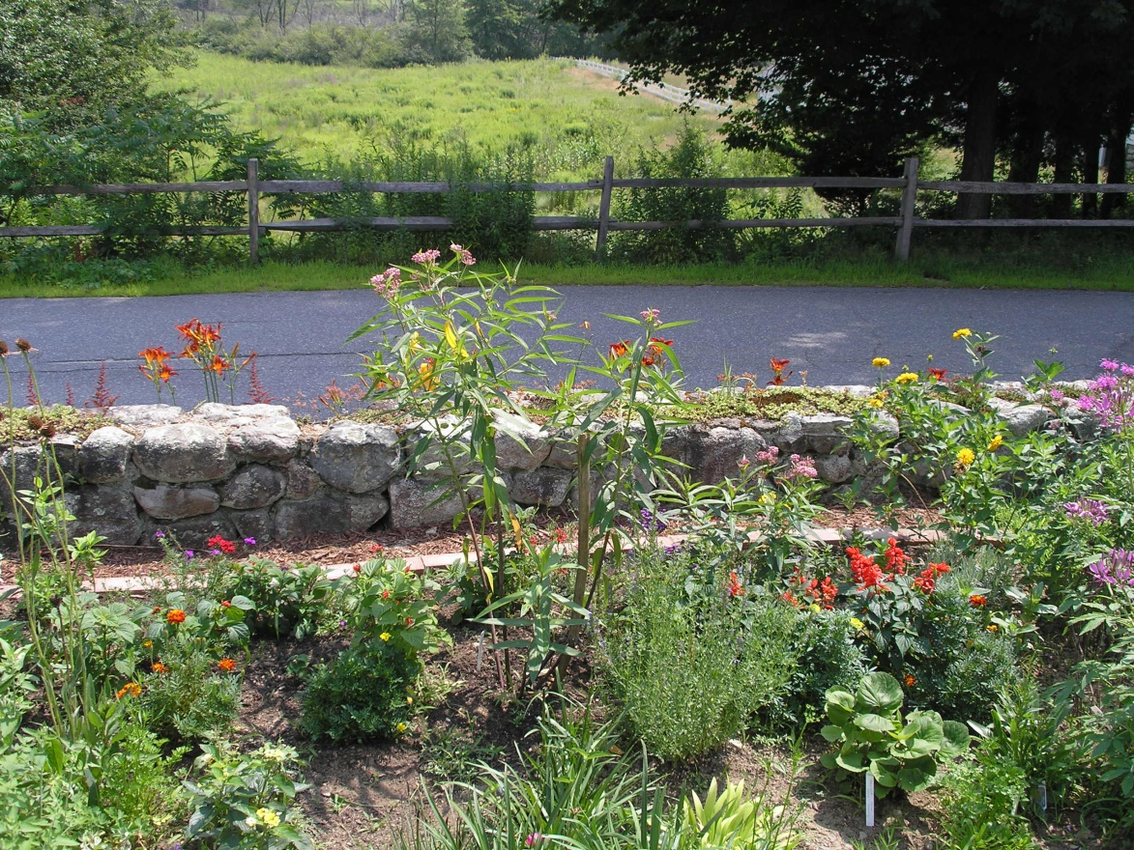
What species are present now?
Are you keeping all the plants in this area?
Yes
Native or non-native (ornamental)
Tree, shrub, perennial?
Are there flowers? If so what is the color, bloom time, and structure?
Notes:
You have plants you want to keep. Can you add native diversity to support more native species? Do you have trees or shrubs that birds can perch on?

Slide 25
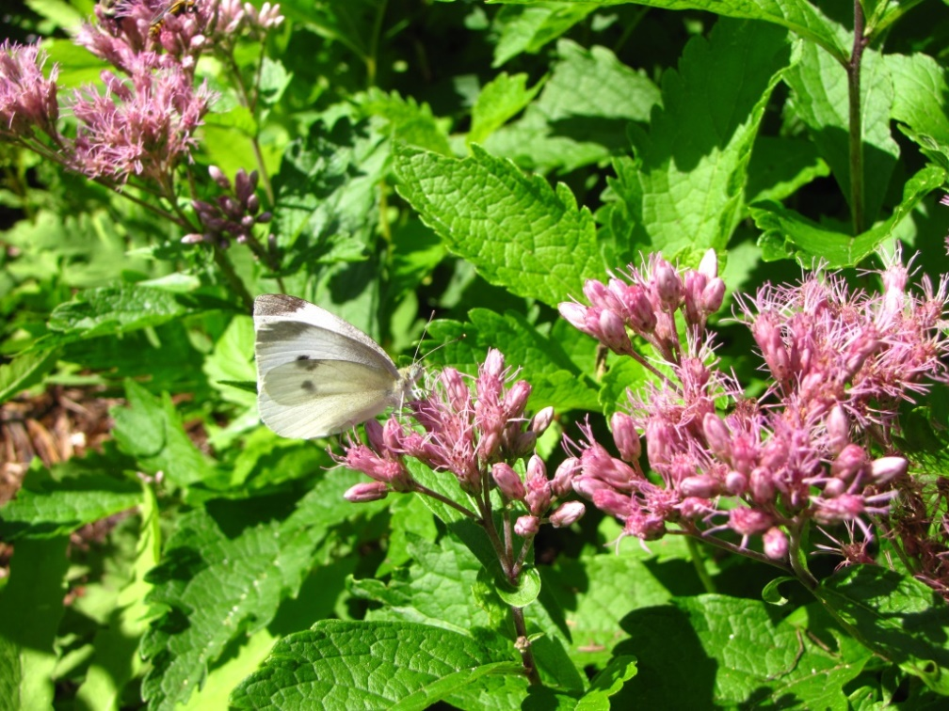
What is your goal?
Bird habitat (nesting and/or food source)
Rain garden to capture excess water
Pollinator garden
Hummingbirds
Native Bees
Butterflies
Beneficial insects (ladybugs, green lacewings etc.)
Reduce lawn coverage
Do you want this garden to serve this function for several seasons?
Notes:
Lastly, what is your goal? Do you want to create more bird habitat? Do you have a lot of water pooling that you would like to get rid of? Increase pollinator habitat? Or do you just hate mowing and want less lawn?

Slide 26
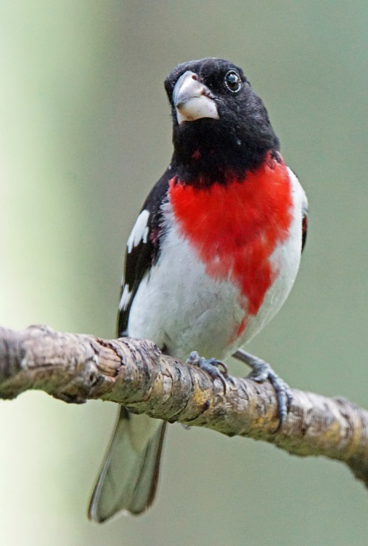
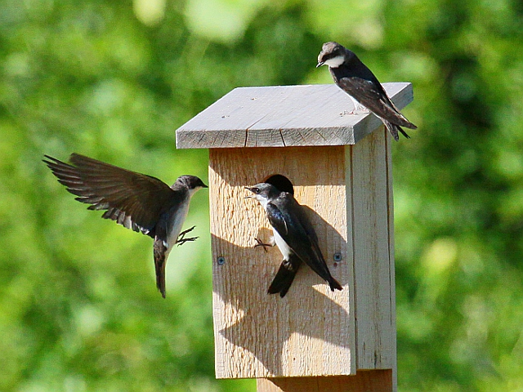
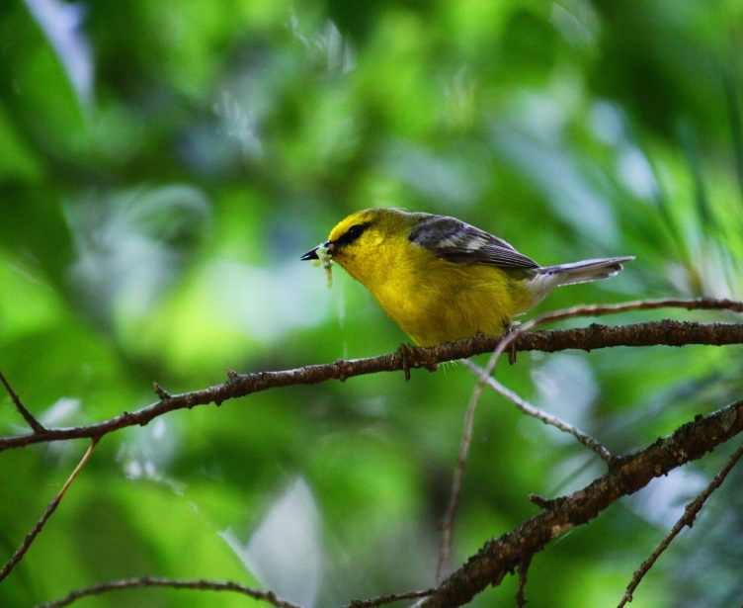
Bird Garden
Once birds visit your garden they are likely to return seasonally
Provide food, shelter and water
Choose plants
with seeds, berries, fruits, nuts
a couple evergreens for shelter
shrubs and ground covers to increase diversity
Joan Chasan
Craig Smith
Craig Smith
Notes:
Be sure to provide food (seed or nut producers), shelter (bird boxes, trees or shrubs) and water (bird bath, pond etc.)

Slide 27
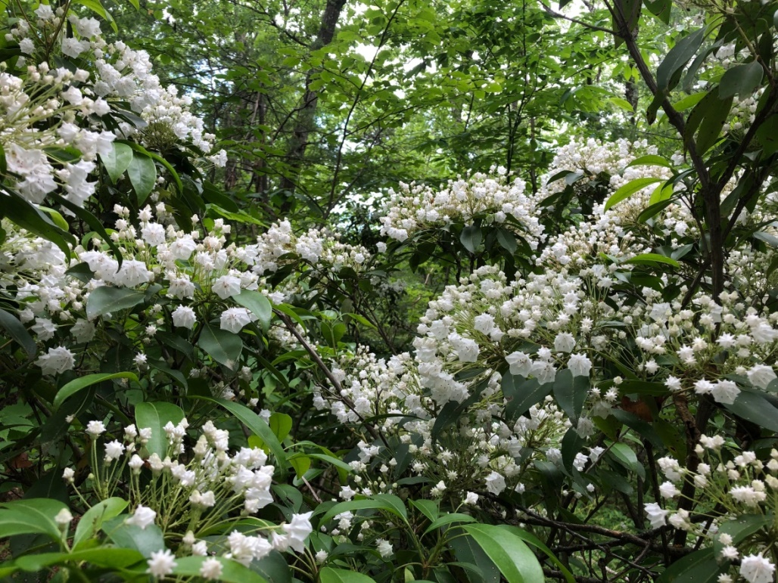
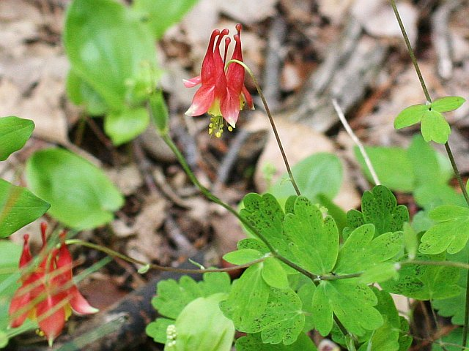
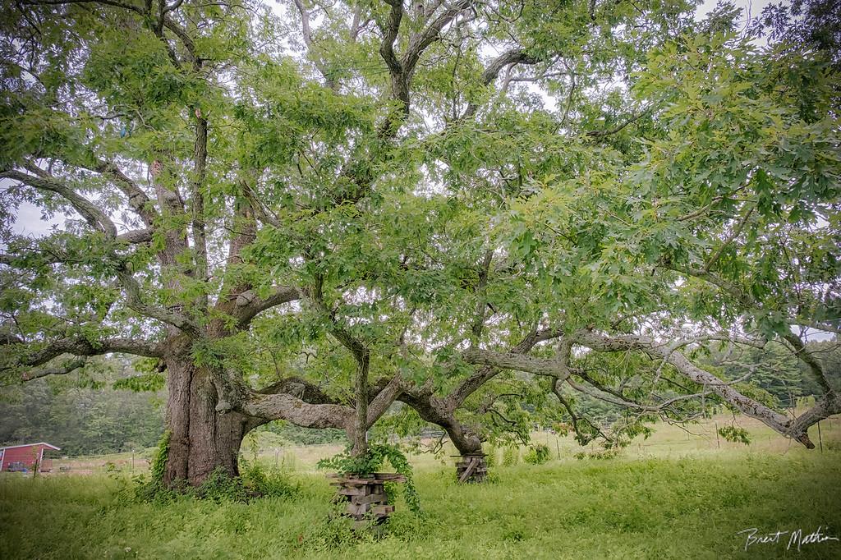
Notes:
Native species that are great at supporting our birds are Mountain Laurel (shrub- shelter, perching), Columbine (early flowering perennial- seeds), White Oak (tree-shelter nesting, perching), and Blueberry (shrub- berries, perching, shelter)

Slide 28
Rain Garden
A shallow depression (manmade or natural) designed to filter and absorb rain water (e.g. near a down spout or naturally wet area the lawn)
Can absorb 30% more water than lawn
Plants remove pollutants from the water before it reaches rivers and lakes
Location- well-drained and on a 1-10% grade slope
Plants- tolerant of temporary pooling and dry periods
Design- wet tolerant plants in the center, drought tolerant on edges
Notes:
When designing this garden you want your more drought tolerant plants along the edges and wet tolerant plants in the center where most of the water will be pooling.

Slide 29
Notes:
Ferns, Cardinal Flower, Turtlehead, Marsh milkweed, New England Aster, Joe-pye weed, red twig dogwood, highbush blueberry

Slide 30
Pollinator Garden
Colorful garden that supports native pollinators- bees, butterflies, hummingbirds, beneficial insects
Location- sunny location and sheltered from wind
Plants- flower structure determines who you attract
Design- variety of height and bloom times and clump similar colors together

Slide 31
Notes:
Joe-Pye Weed, Black eyed Susan, Bee Balm, butterfly weed, milkweed

Slide 32
Reduce your lawn!
Replacing lawn with natives will not only add habitat but will
Increase water absorption
Reduce your time managing it
Reduce mower emissions
Save money on lawn care (water, fertilizer, mowing, pesticides etc.)
Notes:
This is photo is the start of an expanded native flower bed.
More water will be absorbed by natives than your lawn as their root system is much more extensive.
If you plant closely (as in leave enough space between plants for them to reach max width) once everything is full sized you should not need to weed. This planting method will also allow you not to need mulch. Leave the garden standing until early/mid spring, this will give any native pollinators that hibernated on the plant time to emerge. Leave seed heads on the plant (don’t deadhead) for birds and other wildlife to eat.
Gas-powered mowers emit 11 times more air pollution than a new car for each hour of operation.
A well planned native garden should not require additional water (outside the first year or two), fertilizer, or pesticides.

Slide 33
Other fun ways to help Pollinators
Bee hotel
Bird houses
Bird baths or stones with shallow depression
Flat rocks for butterfly basking
Notes:
Bee hotels are for solitary native bees that will hibernate in holes of logs and sticks
Bird baths provide water year round. In winter water is one of their most limited resources and is essential for preening to keep warm.

Slide 34
Seed or Plug
For the most part the difference is cost, patience, and time.
Seeds- take longer to establish but costs significantly less and easier to plant (Rubeckia and Milkweed)
Plugs or larger individuals- Establishes faster but more money and digging required (Pennsylvania sedge)

Slide 35
Native Cultivators
Cultivar-an artificially selected trait that is emphasized in a strain of the straight species e.g. flower color, size
Straight species
Echinacea purpurea
Cultivars have the “fun” names
Echinacea “PowWow Wild Berry”
Flower Form, Jim Robbins
CC BY_NC-NC 4.0
Notes:
It is unclear which, if any native cultivars provide the same nutritional benefit as the straight species. When choosing pick the straight species (there are A LOT of beautiful options)

Slide 36
Rules to the no fuss native garden
Be lazy! Yes, lazy
Once established you should not need to water
Plant close so there are no gaps aka space for weeds
No (or minimal) mulch
Rake leaves (leave mulch) onto flower beds in fall
Use native mints and common milkweed wisely
No pesticides or fertilizers- native plants = native insects = native birds
Cut plants back in spring after temps consistently over 50°
Notes:
Be lazy- don’t clean up the garden in fall or right away in spring, let the temperatures increase a bit before cutting back dead stalks. Don’t plan to water after the plants are established even in a drought, these plants are used to this. Plan your garden close so that when plants are mature they are touch each other, you won’t need to weed as much and won’t need mulch. Mulch the edge of the beds if you want the look but the mulch is not needed in the bed once established. If you want to add mulch while they are establishing do so lightly. Leaf mulch is great in the fall. If you want a more organized garden don’t use mints (bee balm, mountain mint) or common milkweed, they will spread into areas you don’t want it. Don’t used chemicals. Native plants don’t need fertilizer. Native plants support many native insects which support the birds. Our native insects will have a minimal affect on your plants and without them the birds will suffer.

Slide 37
Where to find native plants?
Native Plant Trust
Russells Garden Center
New England Wetland Plants
Vermont Wildflower Farm
Grow Native
Bigelows
Local Conservation District annual plant sales
To learn more about invasives go to www.cisma-suasco.org
To learn more about native pollinators go to www.svtweb.org/native-pollinators
Go Botany!

Slide 38
Questions?

